Slide 1
Introduction to the C Language
By: Amber Hayat
ahayat@ddn.upes.ac.in

Slide 2
Introduction to the C Language
Objectives
❏ To understand the structure of a C-language program.
❏ To write your first C program.
❏ To introduce the include preprocessor command.
❏ To be able to create good identifiers for objects in a program.
❏ To be able to list, describe, and use the C basic data types.
❏ To be able to create and use variables and constants.
❏ To understand input and output concepts.
❏ To be able to use simple input and output statements.

Slide 3
2-1 Background
C is a structured programming language. It is considered a high-level language because it allows the programmer to concentrate on the problem at hand and not worry about the machine that the program will be using. That is another reason why it is used by software developers whose applications have to run on many different hardware platforms.
Notes:
Developed early 1970’s

Slide 4
2-2 C Programs
It's time to write your first C program.
Topics discussed in this section:
Structure of a C Program
Your First C Program
Comments
The Greeting Program

Slide 5
FIGURE 2-2 Structure of a C Program

Slide 6
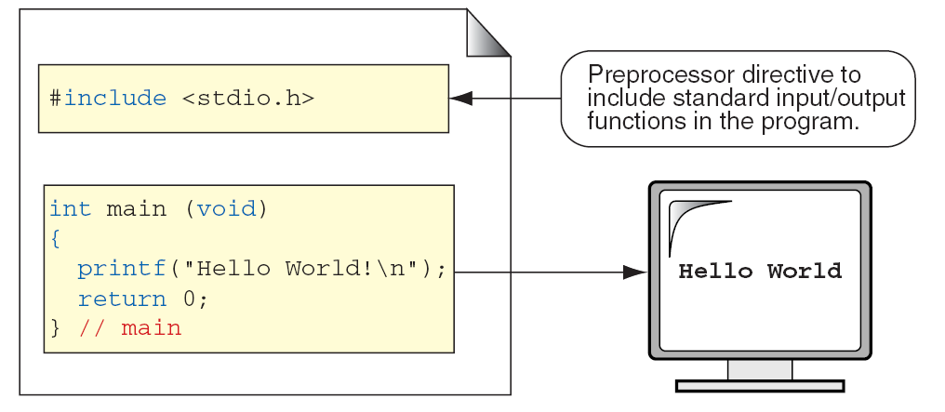
FIGURE 2-3 The Greeting Program

Slide 7
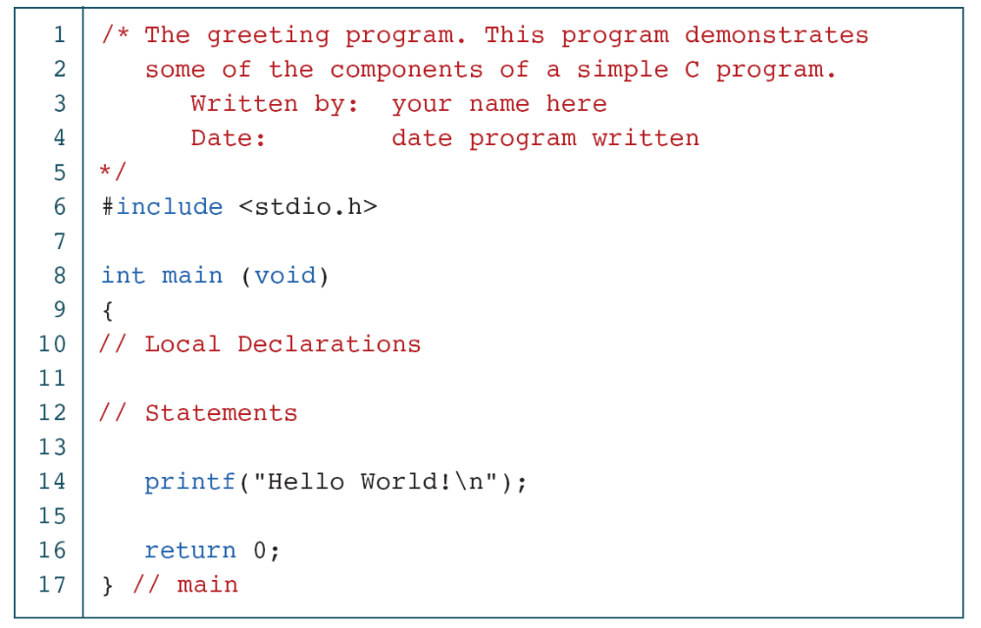
PROGRAM 2-1
The Greeting Program

Slide 8
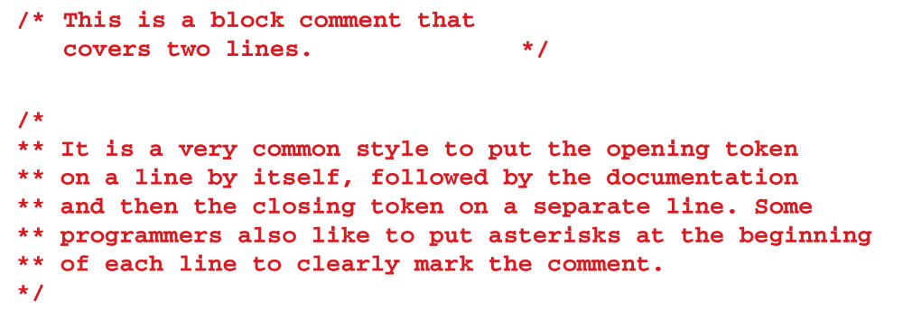
FIGURE 2-4 Examples of Block Comments

Slide 9
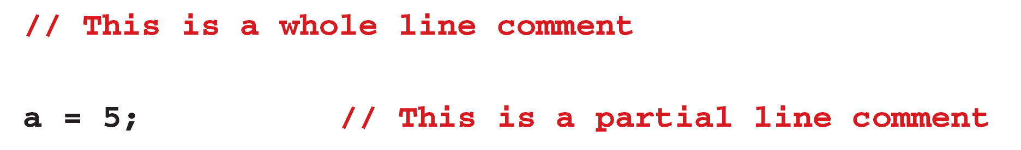
FIGURE 2-5 Examples of Line Comments

Slide 10
2-3 Identifiers
One feature present in all computer languages is the identifier. Identifiers allow us to name data and other objects in the program. Each identified object in the computer is stored at a unique address.

Slide 11
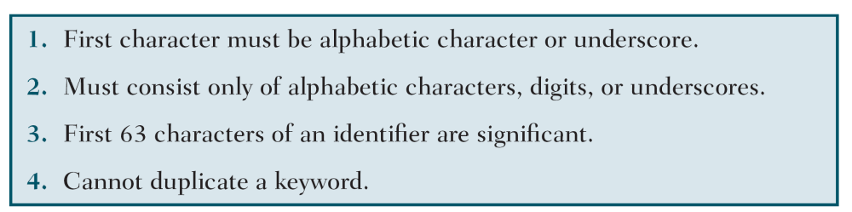
Table 2-1
Rules for Identifiers

Slide 12
Note
An identifier must start with a letter or underscore:
it may not have a space or a hyphen.

Slide 13
Note
C is a case-sensitive language.

Slide 14
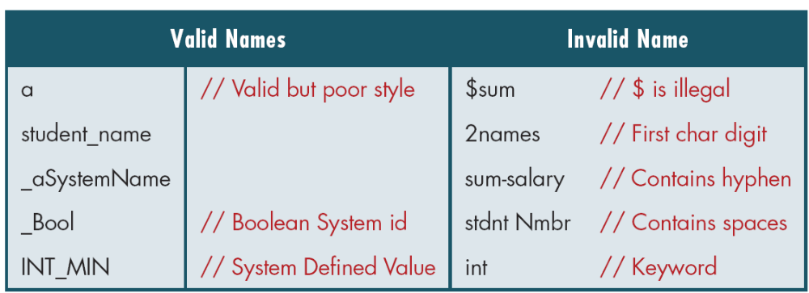
Table 2-2
Examples of Valid and Invalid Names

Slide 15
2-4 Types
A type defines a set of values and a set of operations that can be applied on those values.
Topics discussed in this section:
Void Type
Integral Type
Floating-Point Types

Slide 16
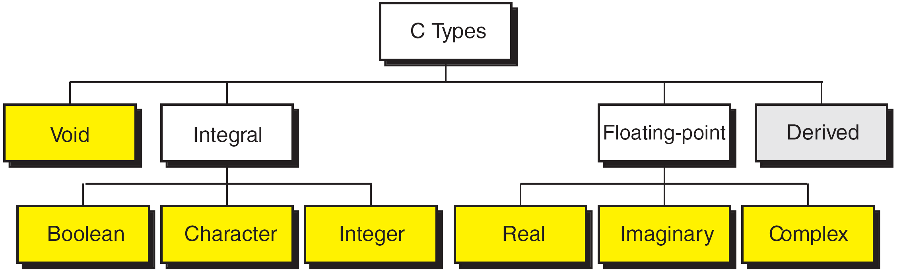
FIGURE 2-7 Data Types

Slide 17
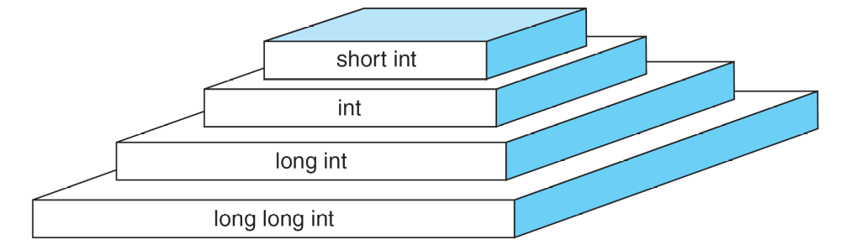
FIGURE 2-9 Integer Types

Slide 18
Note
sizeof (short) ≤ sizeof (int) ≤ sizeof (long) ≤ sizeof (long long)

Slide 19
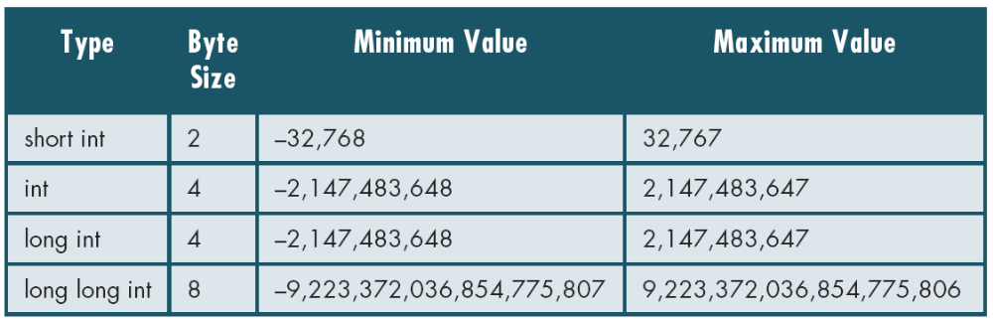
Table 2-3
Typical Integer Sizes and Values for Signed Integers

Slide 20
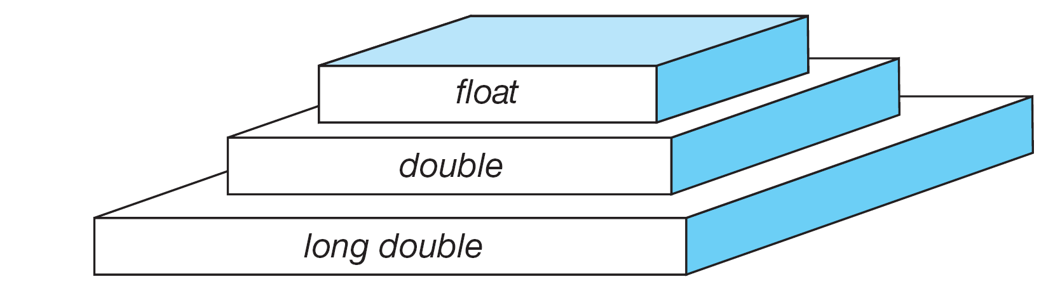
FIGURE 2-10 Floating-point Types

Slide 21
Note
sizeof (float) ≤ sizeof (double) ≤ sizeof (long double)

Slide 22
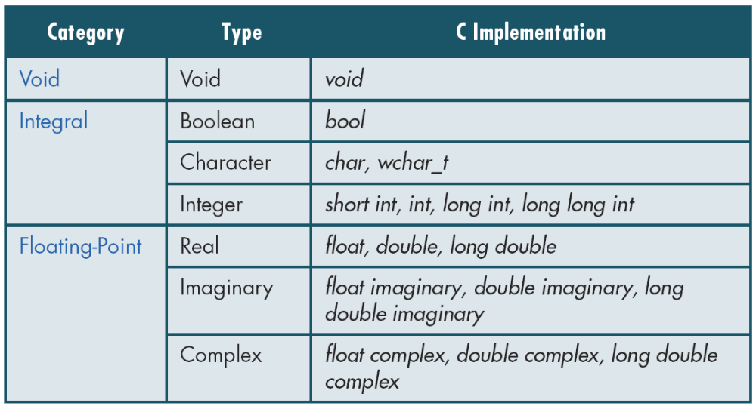
Table 2-4
Type Summary

Slide 23
2-5 Variables
Variables are named memory locations that have a type, such as integer or character, which is inherited from their type. The type determines the values that a variable may contain and the operations that may be used with its values.
Topics discussed in this section:
Variable Declaration
Variable Initialization

Slide 24
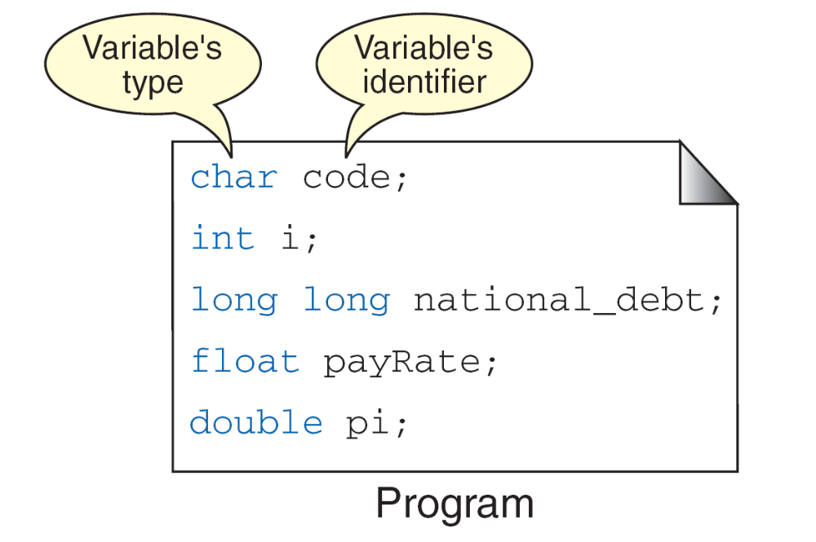
FIGURE 2-11 Variables

Slide 25
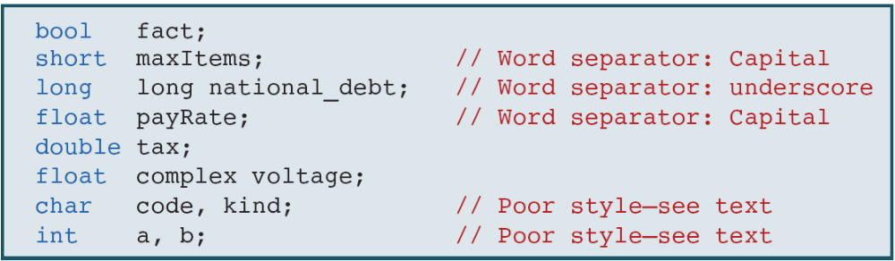
Table 2-5
Examples of Variable Declarations and Definitions

Slide 26
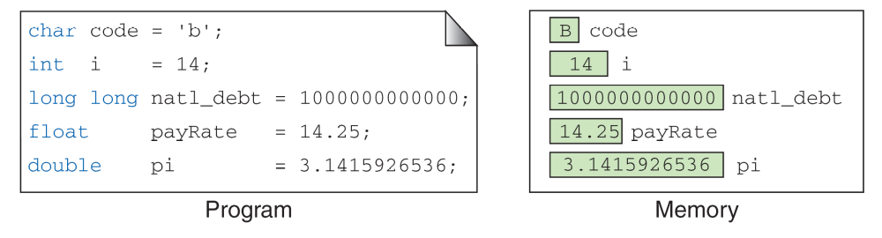
‘B’
FIGURE 2-12 Variable Initialization

Slide 27
Note
When a variable is defined, it is not initialized.
We must initialize any variable requiring
prescribed data when the function starts.

Slide 28
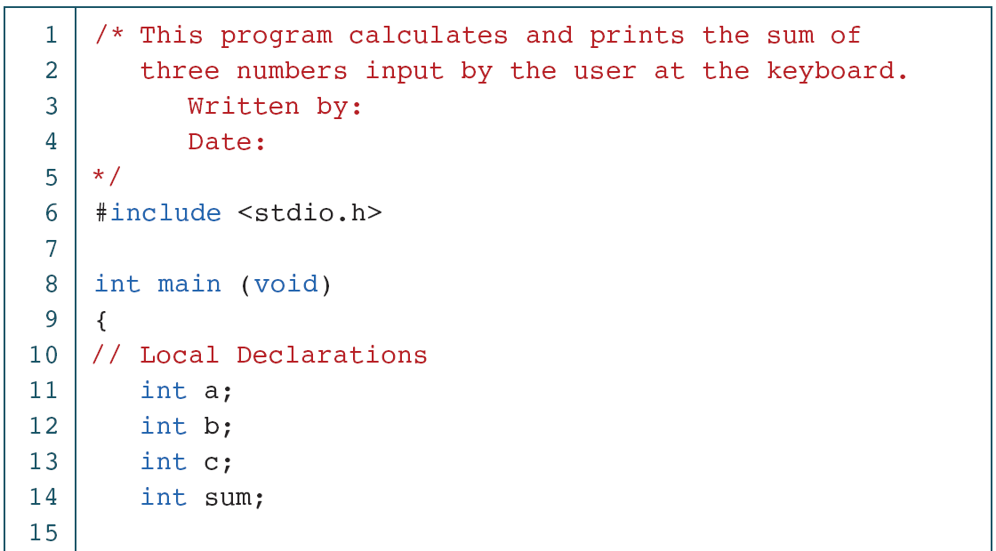
PROGRAM 2-2
Print Sum of Three Numbers

Slide 29
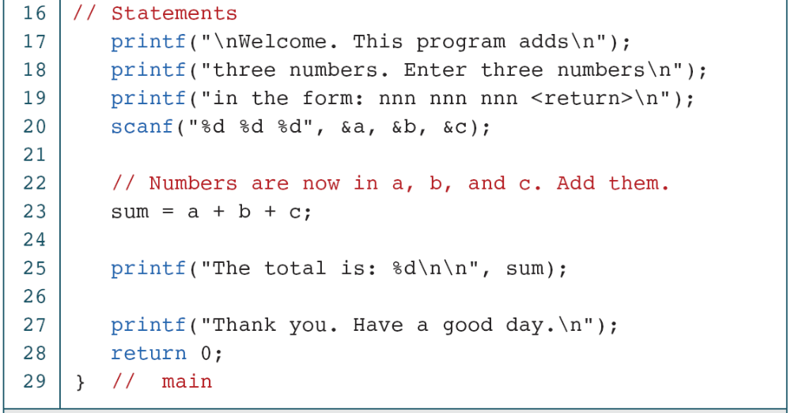
PROGRAM 2-2
Print Sum of Three Numbers (continued)

Slide 30
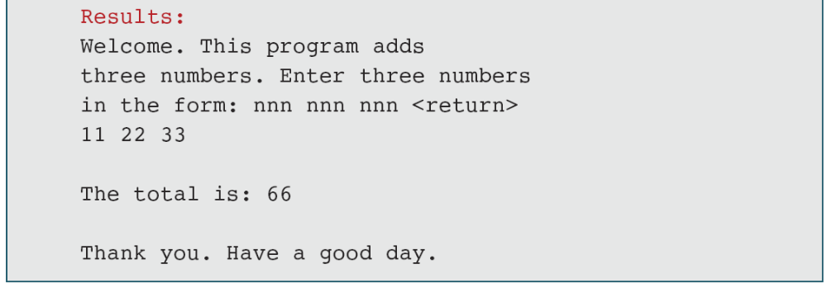
PROGRAM 2-2
Print Sum of Three Numbers (continued)

Slide 31
2-6 Constants
Constants are data values that cannot be changed during the execution of a program. Like variables, constants have a type. In this section, we discuss Boolean, character, integer, real, complex, and string constants.
Topics discussed in this section:
Constant Representation
Coding Constants

Slide 32
Note
A character constant is enclosed in single quotes.

Slide 33
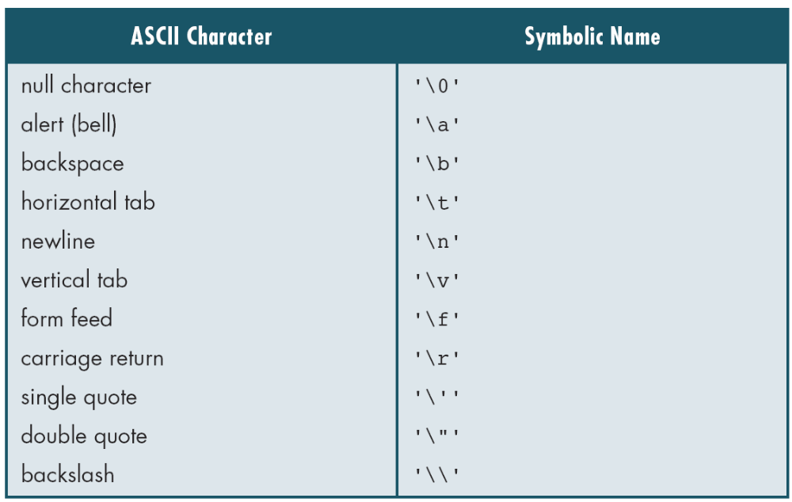
Table 2-6
Symbolic Names for Control Characters

Slide 34
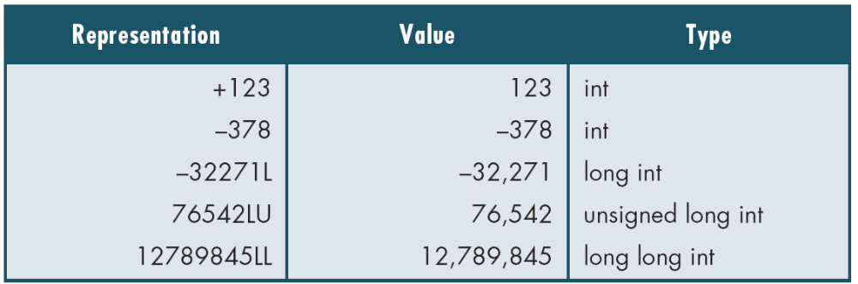
Table 2-7
Examples of Integer Constants

Slide 35
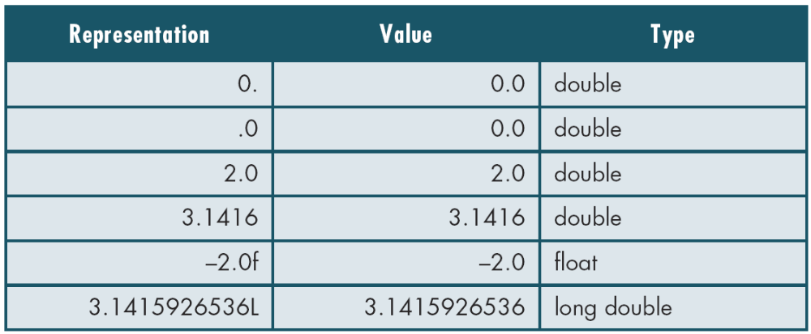
Table 2-8
Examples of Real Constants

Slide 36
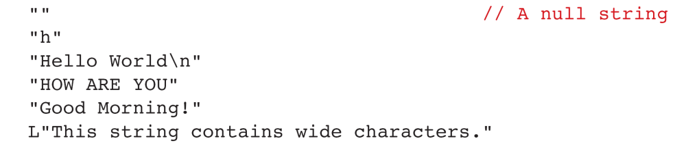
FIGURE 2-13 Some Strings

Slide 37
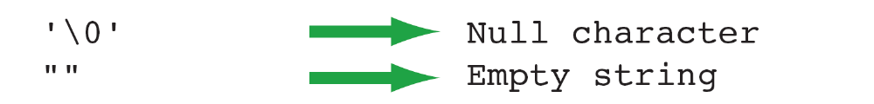
FIGURE 2-14 Null Characters and Null Strings

Slide 38
Note
Use single quotes for character constants.
Use double quotes for string constants.

Slide 39
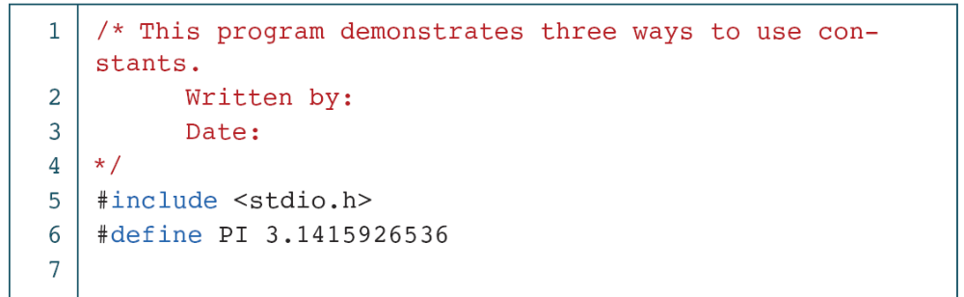
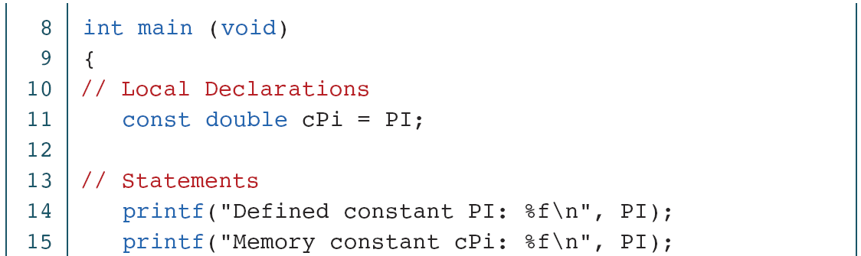
PROGRAM 2-3
Memory Constants

Slide 40
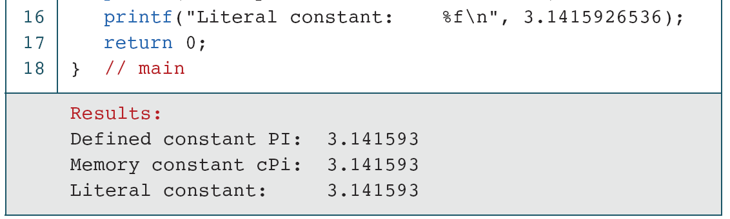
PROGRAM 2-3
Memory Constants (continued)

Slide 41
Bitwise Operators
& | bitwise AND
| | bitwise OR
^ | bitwise XOR
~ | 1’s compliment
<< | Shift left
>> | Shift right
All these operators can be suffixed with =
For instance a &= b; is the same as a = a & b;
ספטמבר 04
Copyright Meir Kalech

Slide 42
Bitwise Operators – truth table
a | b | a&b | a|b | a^b | ~a
0 | 0 | 0 | 0 | 0 | 1
0 | 1 | 0 | 1 | 1 | 1
1 | 0 | 0 | 1 | 1 | 0
1 | 1 | 1 | 1 | 0 | 0
ספטמבר 04
Copyright Meir Kalech

Slide 43
Bitwise Operators - Examples
11010011
&
10001100
------------
10000000
11010011
|
10001100
------------
11011111
11010011
^
10001100
------------
01011111
~11010011
------------
00101100
11010011>>3
------------
00011010
11010011<<3
------------
10011000
ספטמבר 04
Copyright Meir Kalech

